Slide 1
Solution for DSSM
Feng Chi
Yuka Hayashi
14 July 2019

Slide 2
Problem
Need software for Science Education division
Department | Details
Science Education | Insufficient materials for young children (intermediate student) : i.e. Science Learning Hub According to PISA, New Zealand is ranked at 13th in the science score ranking in the world in 2016 -> It is significant for the company to implement the education area for future development in science
Climate Science | Can use Data Analytics tools, machine learning etc.
Biodiversity | The government has data and organise it
Other | Only one person is in charge of it

Slide 3

Solution
Make a website for younger children (intermediate student) in New Zealand to get interested in science.
The website contains different materials with different areas
Videos
Quizzes
Articles

Slide 4
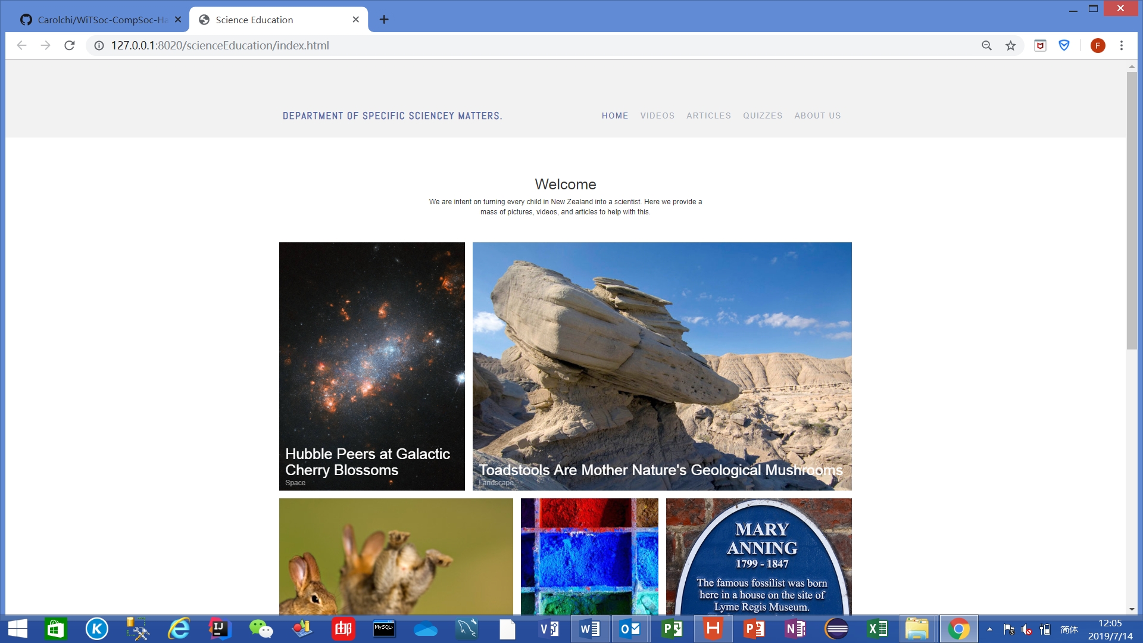
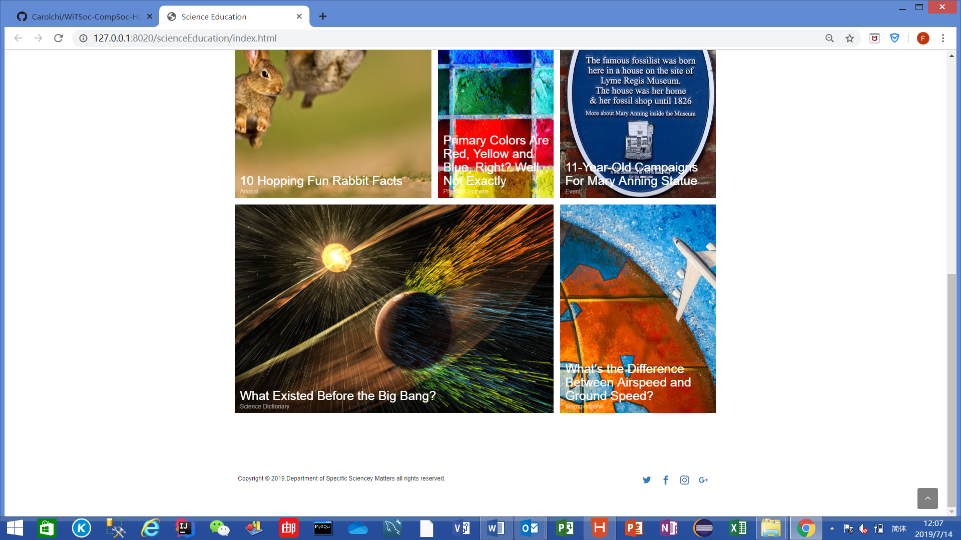
Solution (Demo) -Homepage
Company Logo
Contents
The latest news

Slide 5
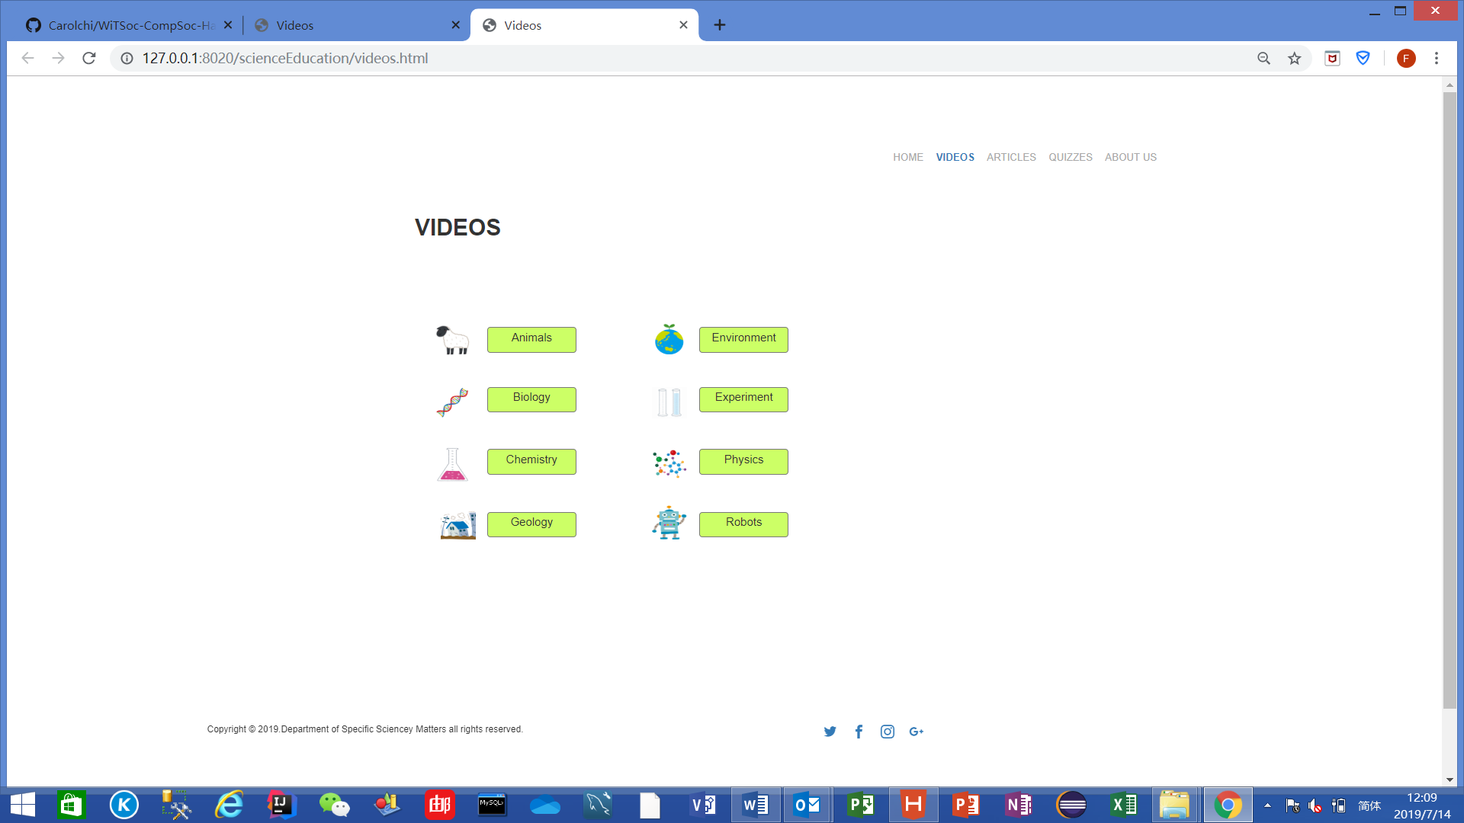
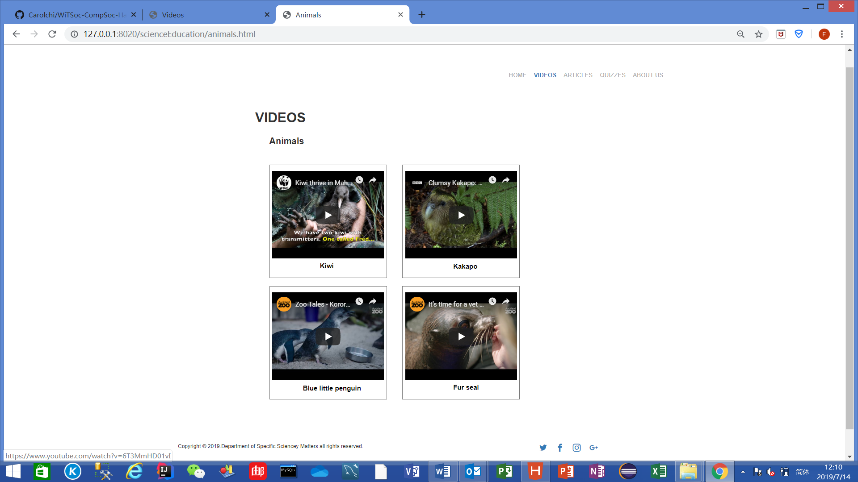
Solution (Demo) -Videos

Slide 6
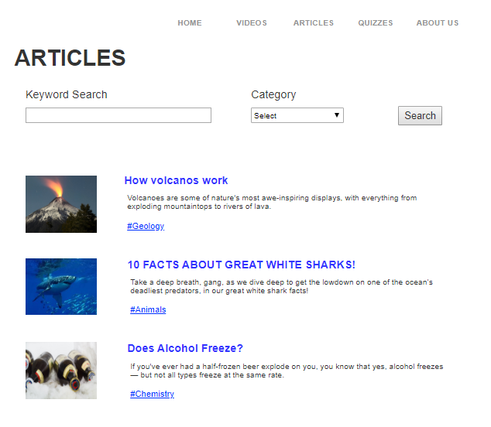
Solution (Demo) -Articles
Keywords
Choose category

Slide 7
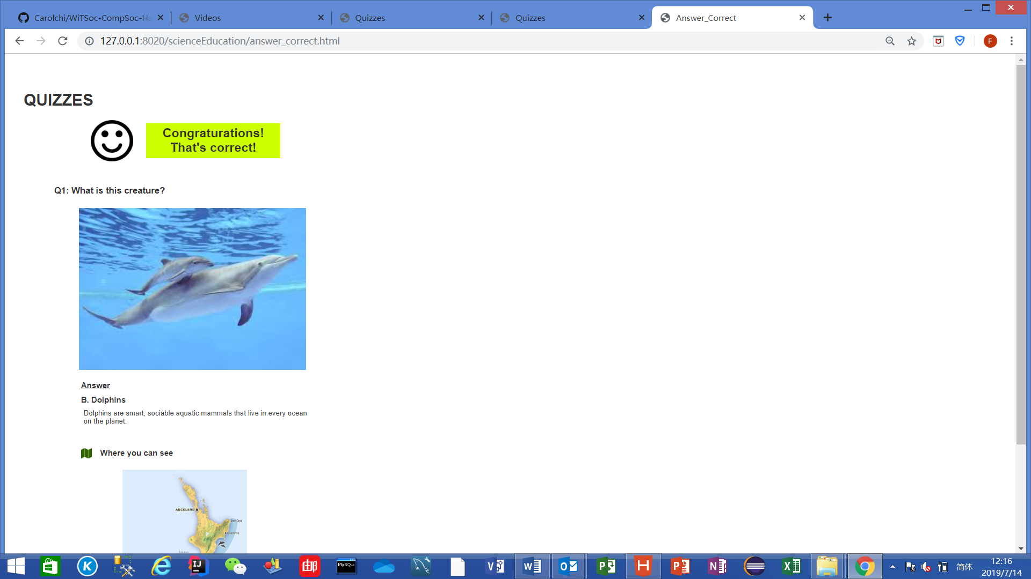
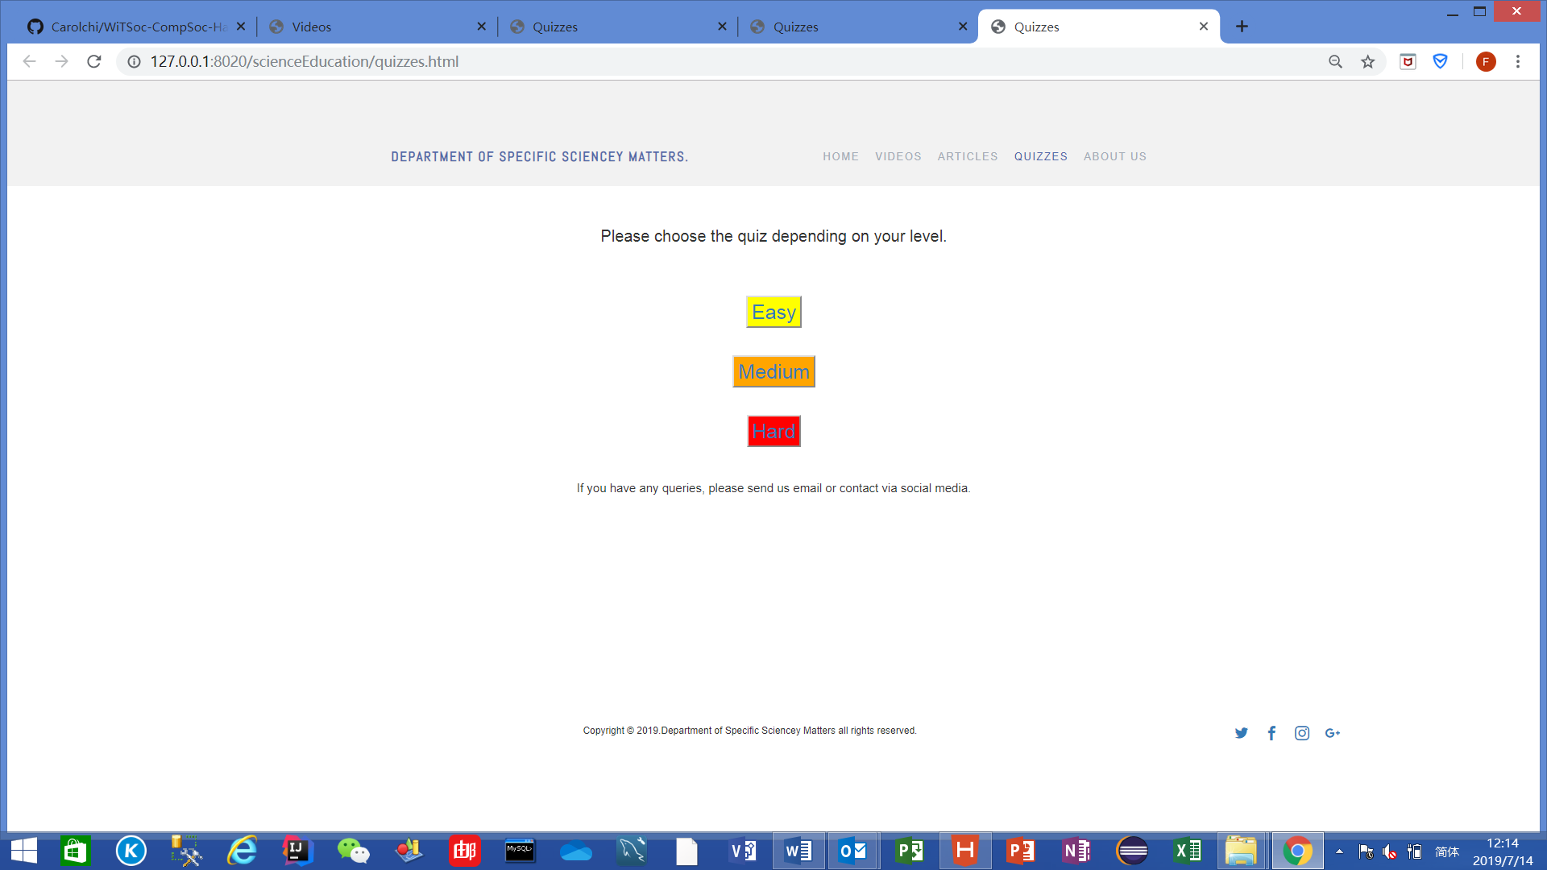
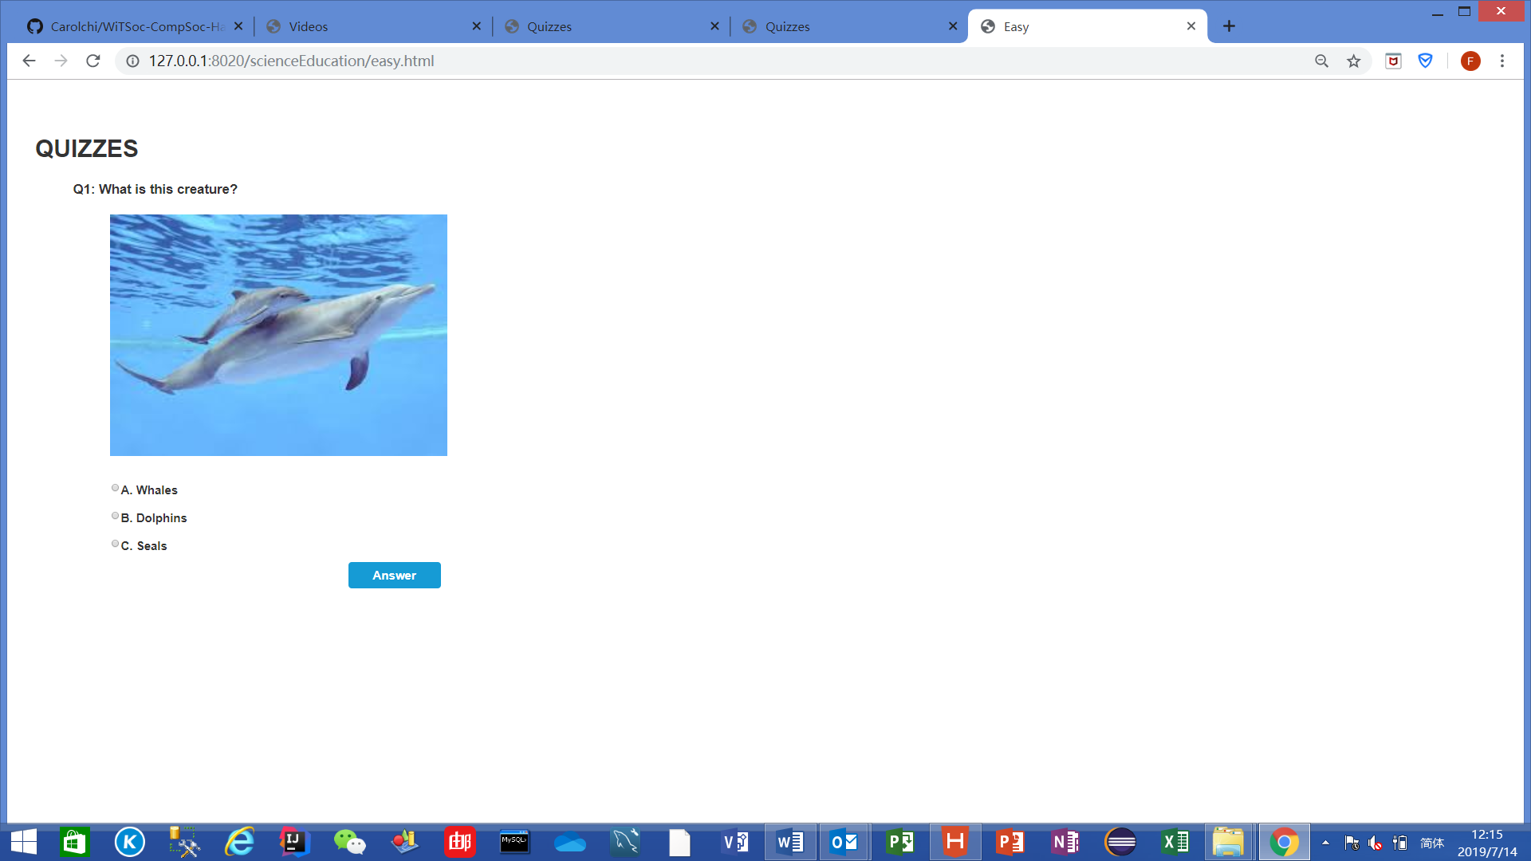
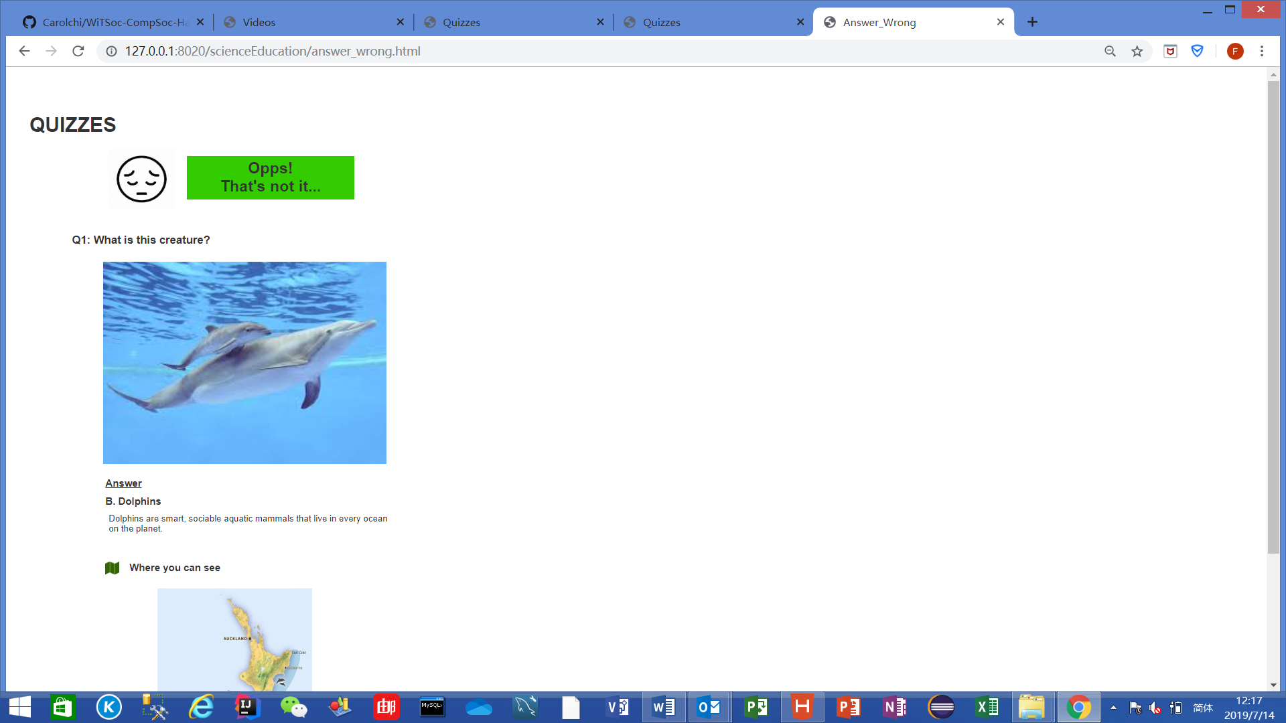
Solution (Demo) -Quizzes

Slide 8
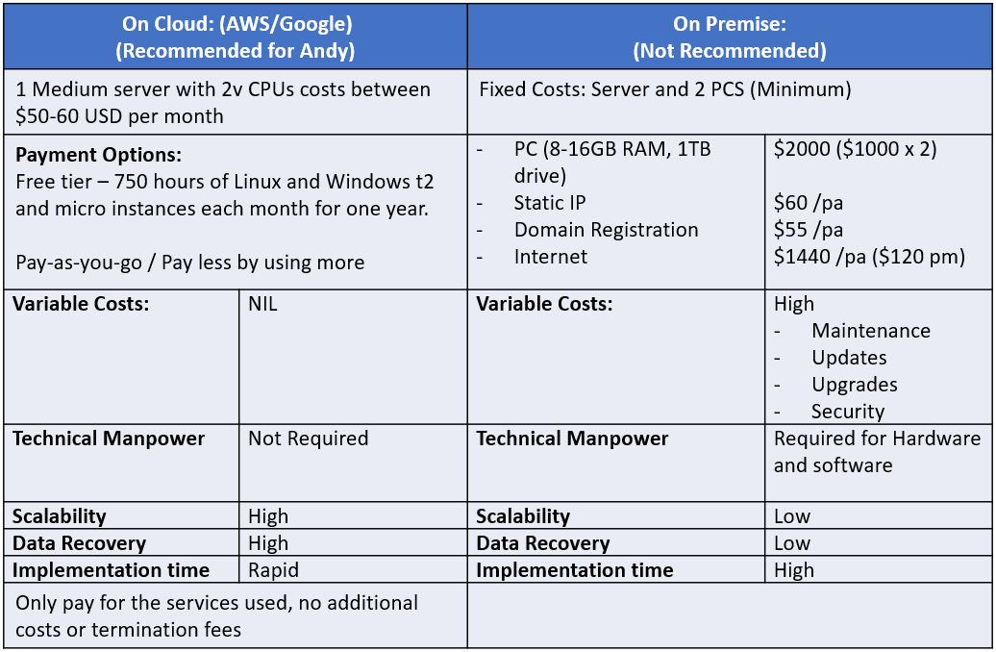
Recommendation for server
DSSM)

Slide 9

Thank you!

